Slide 1
Supply Chain Management Unit 4- creating a sustainable supply chain
Venkadeshwaran K
Associate Professor
School of Mechanical Engineering
FET, JAIN (Deemed to be University)

Slide 2
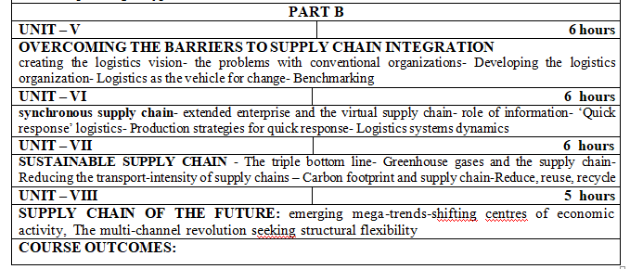
Syllabus

Slide 3
Learning Outcomes
Understand how business operations have an effect upon communities, workers and natural systems.
Identify some of the major threats facing supply chains (and people) in the 21st century.
Discover why recycling isn’t the answer.
See how creative solutions can improve the competitive performance of a business while also addressing the ‘green’ agenda.

Slide 4
Introduction
biggest issues to rise to prominence across every aspect of business and society in the opening years of the twenty-first century has been ‘sustainability’.
Definition of sustainability - meeting the needs of the present without compromising the ability of future generations to meet their own needs.
further augmented by adopting the parallel idea of the ‘triple bottom line’ - emphasises the importance of examining the impact of business decisions on three key arenas:
Environment (e.g. pollution; climate change; the depletion of scarce resources, etc.)
Economy (e.g. effect on people’s livelihoods and financial security; profitability of the business, etc.)
Society (e.g. poverty reduction; improvement of working and living conditions, etc.)

Slide 5
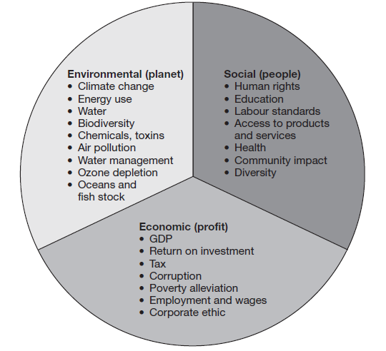
Triple Bottom Line

Slide 6
the two goals (ensuring the long- term viability of business and future well being of the society) are mutually supportive, i.e. supply chain strategies that benefit the wider environment are likely also to involve the business in less cost in the long term as the result of a better use of resources.
supply chain underpins the efficient and effective running of the business it can provide a useful framework for exploring opportunities for improving sustainability.

Slide 7
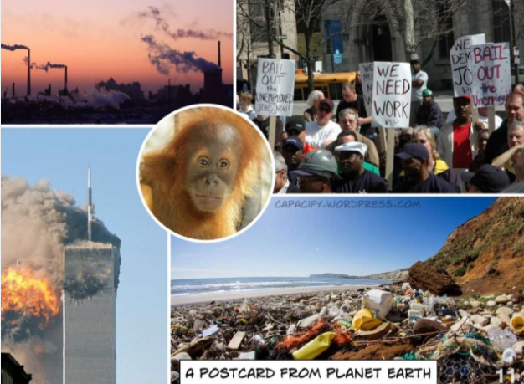
Greenhouse gases and the supply chain

Slide 8
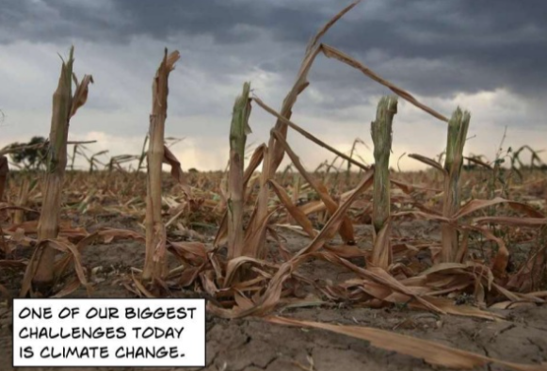
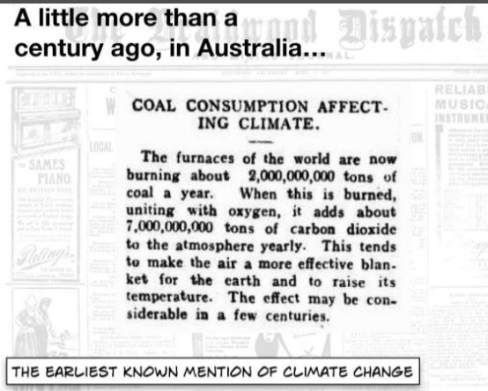
Greenhouse gases and the supply chain

Slide 9
Greenhouse gases and the supply chain
‘greenhouse gases’ include carbon dioxide, methane and nitrous oxide and various fluorocarbons.
‘carbon footprint’ - the amount of greenhouse gases—primarily carbon dioxide—released into the atmosphere by a particular human activity.

Slide 10
Greenhouse gases and the supply chain
Each of the following activities add 1 kg of CO2 to your
personal carbon footprint:
Travel by public transportation (train or bus) a distance of 10 to 12 km (6.5 to 7 miles)
Drive with your car a distance of 6 km or 3.75 miles (assuming
7.3 litres petrol per 100 km or 39 mpg)
Fly with a plane a distance of 2.2 km or 1.375 miles.
Operate your computer for 32 hours (60 Watt consumption assumed)
Production of 5 plastic bags
Production of 2 plastic bottles
Production of 1/3 of an American cheeseburger

Slide 11
Greenhouse gases and the supply chain
How is a carbon footprint calculated?
When calculating a carbon footprint, a lot of factors are taken into consideration.
For example, driving to the grocery store burns a certain amount of fuel, and fossil fuels are the primary sources of greenhouses gases. But that grocery store is powered by electricity, and its employees probably drove to work, so the store has its own carbon footprint.
In addition, the products that the store sells were all shipped there, so that must also be factored into the total carbon footprint.
Beyond that, the fruits, vegetables, and meats that the store sells were all grown or raised on farms, a process that produces methane, which has a greenhouse effect 25 times greater than CO₂.
All of those elements must be combined to understand the full carbon footprint of a given activity.

Slide 12
Greenhouse gases and the supply chain
some of the major causes of greenhouse gases arise from industrial activities such as manufacturing, energy production and transportation.
the author of The World is Flat, is a case in point estimates that the approximately 400 different components in his Dell computer had travelled hundreds of thousands of miles from all their different sources and through the assembly and distribution process to reach him.
growing awareness amongst consumers of the issue of ‘food miles’ – in other words how far food travels from its origin to the point of final consumption

Slide 13
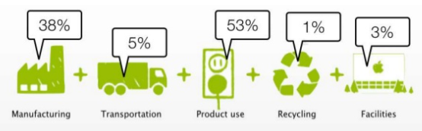
Greenhouse gases and the supply chain
Carbon foot print
Carbon Footprint Carbon dioxide is just one ‘greenhouse gas’, but it provides a useful basis for comparison: CO2e Everything in the supply chain has carbon consequences: sourcing of raw materials, processing, manufacture, transportation, the use phase, and the eventual end-of- life. Manufacturing Transportation Product use Recycling Facilities

Slide 14
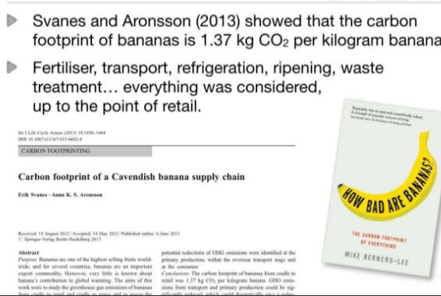
Carbon foot print example

Slide 15


Greenhouse gases and the supply chain
12,000-mile round trip to have seafood shelled
A seafood firm was accused of ‘environmental madness’ yesterday for choosing to send langoustines on a 12,000-mile round trip to Thailand to have their shells removed.
After the shellfish are caught in Scottish waters they will be frozen and shipped to the Far East where they will be peeled by hand and sent back to be sold as scampi. The move by Young’s Seafood is costing 120 jobs at a plant in Annan, south-west Scotland, where the langoustines have been peeled mechanically.
The firm claims that removing the shells by hand enhances the taste, but UK wage costs – at £6 an hour, compared with about 25p an hour in Thailand – are prohibitive.
Friends of the Earth Scotland said the move was ‘madness and would add to global warming’.

Slide 16
Greenhouse gases and the supply chain
there has been a growing awareness amongst consumers of the issue of ‘food miles’ – in other words how far food travels from its origin to the point of final consumption
12,000-mile round trip to have seafood shelled
A seafood firm was accused of ‘environmental madness’ yesterday for choosing to send langoustines on a 12,000-mile round trip to Thailand to have their shells removed.
this will almost certainty change as a result of carbon taxes, emission trading schemes and regulatory change. Hence the need for supply chain managers to think hard about alternative strategies

Slide 17
Greenhouse gases and the supply chain
Recent years have seen a considerable growth of awareness of the potential harm to the environment that can be caused by so-called ‘greenhouse gases’.
some of the major causes of greenhouse gases arise from industrial activities such as manufacturing, energy production and transportation.

Slide 18
Reducing the transport-intensity of supply chains
continued upward trend in global sourcing has inevitably led to products travelling greater distances.
is a reflection of the miles/ kilometres travelled per unit of product shipped.
practical steps can organisations take to improve the transport-intensity of their supply chains are
review product design and bill of materials
review sourcing strategy
review transport options
Improve transport utilisation
Use postponement strategies

Slide 19
Reducing the transport-intensity of supply chains
number of transportation strategies that can be used by management to help reduce costs.
Fewer Carriers
Consolidating Shipments
Single Sourcing

Slide 20
Reducing the transport-intensity of supply chains
PEAK OIL
The concept of ‘peak oil’ originated as far back as 1956 when Dr marion King Hubbert, a geologist at Shell, first coined the phrase.
Peak oil is the point at which we can no longer increase the amount of crude oil we extract and globally petroleum production goes into irreversible decline. Today’s supply chains are more energy intensive than before because they are more transport intensive than they used to be.
Focused factories and centralised distribution
Global sourcing and offshore manufacturing.
Just-in-time deliveries

Slide 21
Peak Oil
Today’s supply chains are more energy intensive than before because they are more transport intensive than they used to be. There are a number of reasons for this including:
Focused factories and centralised distribution – as a result of rationalising production and distribution, many companies are now having to serve cus- tomers at a greater distance.
Global sourcing and offshore manufacturing – the well-established trend to low-cost country sourcing and manufacturing has meant that supply chains are significantly extended and products travel much further.
Just-in-time deliveries – as more customers demand just-in-time deliveries from their suppliers, it is inevitable that shipment sizes reduce whilst delivery frequencies increase.

Slide 22
Beyond the carbon footprint
Rather than limiting the focus of attention to reducing greenhouse gas emissions, it is important to recognise the effect of economic activity on the use of scarce resources across the value chain as a whole.

Slide 23
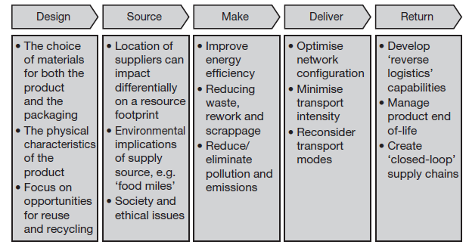
Beyond the carbon footprint

Slide 24
Beyond the carbon footprint
. Some examples of the resource implications of supply chain decisions are described below.

Slide 25
Beyond the carbon footprint
Design
We have previously argued that the supply chain ‘starts on the drawing board’, meaning that decisions that are taken regarding the design of the product can have a significant impact across the supply chain.
This is particularly true when considering the supply chain’s ‘resource footprint’.
More and more companies are actively seeking to reduce the amount of packaging material that is used,
for example, but there can be other, less obvious ways to improve resource sustainability.
If those managers responsible for new product development are not aware of the resource implications of their design decisions, this may lead to the launch of products with a bigger than desirable resource footprint. For example, many high- tech products rely for their functionality on scarce materials such as the so-called ‘rare earth metals’ (e.g. dysprosium and neodymium) whose future availability may increasingly be limited.

Slide 26
Beyond the carbon footprint
Source
‘Sustainable sourcing’ is emerging as a fundamental element of best practice procurement. one reason for this is that it is estimated that for a manufacturer somewhere between 40 and 60 per cent of their total carbon footprint lies upstream of their operations, whilst for retailers it can be as high as 80 per cent.
Depending on where and how those upstream materials and products are sourced and made, there can be major differences in resource consumption.
For example, SAB miller, one of the world’s biggest beer producers, compared its ‘water footprint’ in two different countries – South Africa and the Czech Republic.

Slide 27
Reducing the transport-intensity of supply chains
It actually required 155 litres of water to produce a litre of beer in South Africa against 45 litres of water required to produce a litre of beer in the Czech Republic
Because newsprint production is a highly energy-intensive manufacturing process and since most electricity generated in Sweden is from renewable hydro sources– unlike in the UK where most electricity is generated from coal or gas – the most sustainable manufacturing source was Sweden, not the UK!

Slide 28
Beyond the carbon footprint
Make
Manufacturing processes affect the resource footprint primarily through their use of energy, their relative efficiency and the creation and disposal of waste and toxic materials/effluents. In this age of outsourcing and offshore manufacturing it may not always be apparent to the customer what impact manufacturing strategy decisions can have on supply chain sustainability. However, it is evident that there are big differences in the energy efficiency of different factories and also in the waste they generate and how they dispose of it. Even the source of energy has sustainability implications.

Slide 29
Beyond the carbon footprint
Make
For example a study conducted by the UK Carbon Trust looked at the different footprints created by a UK national daily newspaper when it used newsprint produced in Sweden compared to newsprint made in the UK. Because newsprint production is a highly energy-intensive manufacturing process and since most electricity generated in Sweden is from renewable hydro sources– unlike in the UK where most electricity is generated from coal or gas – the most sustainable manufacturing source was Sweden, not the UK!

Slide 30
Beyond the carbon footprint
Deliver
Clearly decisions on the mode of transport will affect the carbon footprint of a supply chain as will the extent to which transport capacity is efficiently used.
Many models tend to optimise on a narrow definition of cost rather than taking into account the wider resource footprint that is created by the network.
A new generation of network optimisation tools is now emerging which take account of the carbon footprint as well as the more conventional costs.

Slide 31
Beyond the carbon footprint
Return
‘Reverse logistics’ is the term usually used to describe the process of bringing products back, normally at the end-of-life, but also for recall and repair.
In the past, little attention was paid to the challenge of reverse logistics, often resulting in extremely high costs being incurred.
Now, partly driven by increasingly stringent regulations – particularly on product disposal and reuse/recycling requirements – the issue has moved much higher up the agenda.
Essentially the challenge today is to create ‘closed-loop’ supply chains that will enable a much higher level of reuse and recycling.

Slide 32
Reduce, reuse, recycle
Many companies are now actively seeking to create marketing strategies that emphasise the ‘greenness’ of their supply chains.
Strong evidence is emerging that consumers are increasingly basing their purchasing behaviour on ethical and environmental criteria.

Slide 33
Reduce, reuse, recycle
Water: The next oil? As the world’s population continues to increase and as climate change impacts on rainfall, there is an increasing mis-match between supply and demand for water. Supply chains are big consumers of water when all the different production and manufacturing processes involved from start to finish are considered
Some examples of the water footprint of different products and commodities are shown below.
How much water does it take …
To make a cup of coffee? 140 litres
To make a litre of milk? 1,000 litres
To make a hamburger? 2,400 litres
To make a t-shirt? 2,500 litres
To make a pair of jeans? 10,850 litres
To produce a kilogram of beef? 16,000 litres
Many companies are now actively seeking to create marketing strategies that emphasise the ‘greenness’ of their supply chains.

Slide 34
Reduce, reuse, recycle
Both Wal-mart and Tesco (and other retailers too) intend to provide information on the labels of the products they sell detailing the overall environmental impact of those items. To do this they are working closely with their suppliers to ensure that their supply chain arrangements are sustainable and that they continue to seek innovative ways to improve the end-to- end environmental footprint.
For example, Tesco recognised that glass bottles, because of their weight, add significantly to transport intensity and overall carbon emission.
By working with suppliers to create lighter weight wine bottles, Tesco reduced its annual glass usage from one single supplier by 2,600 tonnes – a 15 per cent saving.
Further savings were achieved by importing wines into the UK from Australia in bulk and then bottling them in lightweight glass in the UK.

Slide 35
Reduce, reuse, recycle
Further pressure on businesses to reduce their environmental footprints is coming from government regulation, often in the form of Emission Trading Schemes (ETS) or so-called ‘Cap and Trade’ legislation.
Since, as we have noted, most of a typical business’s total environmental foot- print lies in its wider supply chain, particularly upstream of its own operations, the need for supply chain managers to become more involved in managing this foot- print becomes apparent.

Slide 36
Impact of congestion
One of the key issues when considering sustainable supply chain solutions is traffic congestion and the related infrastructure issues
There have been a number of causes of this problem, including
increased global trade,
lack of investment in capacity and
the widespread adoption of just-in- time practices
there is likely to be some alleviation as a result of the application of what might be termed ‘smart logistics’ and ‘intelligent transport’.
Smart logistics works by aggregating and combining individual shipments into consolidated loads for final delivery. ‘Cross docking’ is an example of this idea
advanced IT solutions such as dynamic vehicle routing and scheduling and intelligent agent modelling

Slide 37
increased global trade,
With the growth in offshore manufacturing and the emergence of new markets, alongside the removal of trade barriers, the flow of products across borders has increased dramatically.

Slide 38
lack of investment in capacity
Paradoxically in some developed countries environmental concerns have led to unwillingness to build more infrastructure such as new motorways or port extensions.
in developing countries the sheer scale of the investment required to meet the demand is daunting.

Slide 39
the widespread adoption of just-in- time practices
Over the last 50 years there has been a significant uptake across all sectors and supply chains of the philosophy and practice of just-in-time (JIT).
aggregation and consolidation there can be no doubting that it has contributed to an increase in shipments and movements.
that concern with environmental issues has become much more prevalent,

Slide 40
Smart logistics
Smart logistics works by aggregating and combining individual shipments into consolidated loads for final delivery. ‘Cross docking’ is an example of this idea whereby different suppliers ship complete truck loads to a distribution centre, typically with each pallet bar-coded or RFID-tagged with product and destination details, for resortment and consolidation with other shipments to the same final destination.
The same principle can be used utilising ‘logistics platforms’ on the edge of large cities or conurbations to reduce individual deliveries to congested locations.

Slide 41
intelligent transport
When advanced IT solutions such as dynamic vehicle routing and scheduling and intelligent agent modelling are used alongside these collaborative strategies, many things become possible – particularly enabling the better management of constrained capacity against a backdrop of uncertain demand.

Slide 42
References
World Commission on Environment and Development, our common Future, oxford University Press, 1987.
Elkington, J., cannibals with Forks: The Triple bottom line for 21st century business, Capstone Publishing, oxford, 1997.
Stern, N., Stern review on the Economics of climate change, Hm Treasury, london, 2000.
Gore, A., an inconvenient Truth, Bloomsbury, london, 2006.
Friedman, T., The World is Flat, Allen lane, UK, 2005
Botte, H., meyer, T. and Stuchtey, m., ‘An energy efficiency resolution in supply chains’, Mckinsey Quarterly, August 2009.
Holliday, C.o., Schmidheing, S. and Watts, P., Walking the Talk: The business case for Sustainable Development, Bennett-Koehler Publishers Inc., San Francisco, 2002.
Brickmann, C. and Ungerman, D., ‘Climate change and supply chain management’, Mckinsey Quarterly, July 2008.

